Slide 1
Module – 3
ML Concepts, Algorithms & Model Evaluation
Dr. Rakhee Chhibber

Slide 2
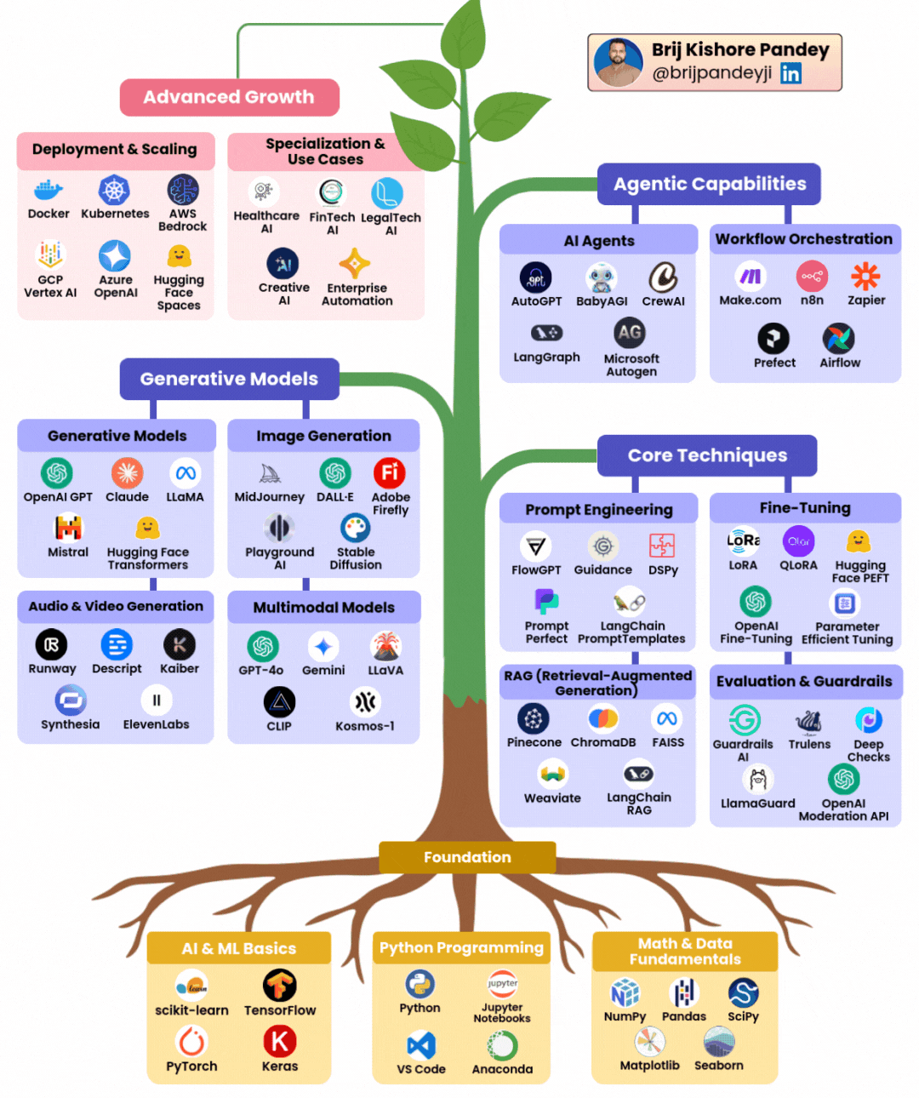
The Skill Tree You need to grow in Gen - AI

Slide 3
Module 3: Machine Learning
1. ML Concepts | 2. ML Algorithms
Supervised vs Unsupervised Semi-supervised Reinforcement learning basics ML workflow Feature engineering Model training, validation, testing Hyperparameter tuning | Linear & Logistic Regression KNN Decision Trees & Random Forest SVM Ensemble Learning KMeans, DBSCAN PCA
3. Model Evaluation | 4. Tools And Assignments
Classification metrics Regression metrics Confusion matrix ROC/AUC | ✔ Scikit-learn, Jupyter Assignments Build regression & classification models Fraud detection model Clustering customer segmentation

Slide 4
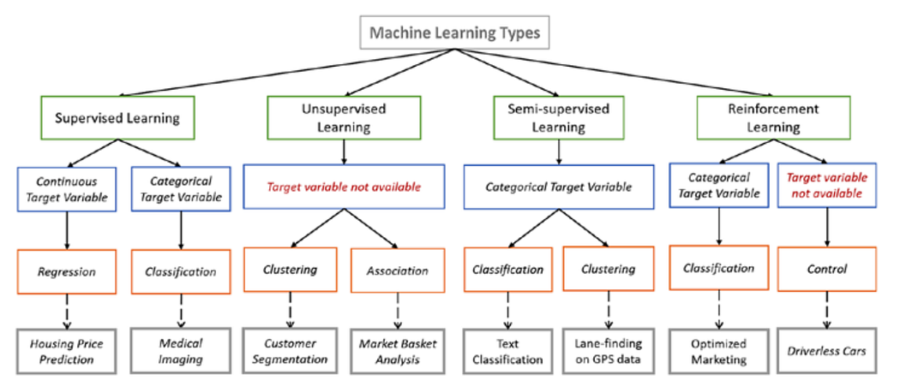

Slide 5
Supervised Learning
Definition: Supervised learning is an ML approach where the model is trained on labeled data, meaning each input has a known output.
Goal: Learn a mapping function:
X (input features) → Y (target/label)
Model - Predictive
Types of Supervised Learning
(a) Regression
(b) Classification

Slide 6
(a) Regression
Output is continuous
Examples:
  House price prediction
  Salary prediction
Algorithms:
Linear Regression
Ridge / Lasso

Slide 7
(b) Classification
Output is categorical
Examples:
  Spam vs Not Spam
  Fraud detection
Algorithms:
Logistic Regression
KNN
SVM
Naive Bayes
Decision Tree

Slide 8
Advantages and Disadvantages
Advantages:
- High accuracy when enough labeled data is available
- Easy evaluation using metrics
Disadvantages:
Requires large labeled datasets
Labeling is expensive

Slide 9
Unsupervised Learning
Definition: Unsupervised learning works with unlabeled data. The model finds hidden patterns or structures.
Goal: Discover intrinsic structure in data.
Types of Unsupervised Learning
(a) Clustering
(b) Dimensionality Reduction

Slide 10
a) Clustering
Groups similar data points
Examples:
  Customer segmentation
  Image grouping
Algorithms:
K-Means
Hierarchical Clustering

Slide 11
(b) Dimensionality Reduction
Reduce number of features while retaining information
Algorithms:
PCA → Principal Component Analysis – used in Dimensionality Reduction like image compression, noise Reduction
- LDA → Linear Discriminant Analysis – used in face recognition, spam detection, document classification, medical diagnosis as diabetes detection and cancer detection etc.

Slide 12
Advantages and Disadvantages
Advantages:
No labeling required
- Useful for exploration
Disadvantages:
No direct accuracy metric
Interpretation can be difficult

Slide 13
Semi-Supervised Learning
Definition: Uses small labeled data + large unlabeled data.
Why needed?
Labeling is costly
Unlabeled data is abundant
Approach: 1. Train model on labeled data 2. Predict labels for unlabeled data 3. Retrain using confident predictions
Examples:
Text classification
Medical image analysis
Techniques:
Self-training
Co-training
Pseudo-labeling

Slide 14
Reinforcement Learning (RL) Basics
Definition: Learning by interaction with an environment using rewards and penalties.
Objective
Maximize cumulative reward.
Return = r1 + r2 + r3 + ...
Examples
Game playing (Chess, Go)
Robotics
Recommendation systems
Algorithms
Q-Learning
SARSA
Deep Q Networks (DQN)

Slide 15
Machine Learning Workflow
End-to-End ML Pipeline
  Problem Understanding
  Data Collection
  Data Cleaning
  Exploratory Data Analysis (EDA)
  Feature Engineering
  Model Selection
  Model Training
  Validation & Testing
  Hyperparameter Tuning
  Deployment & Monitoring

Slide 16
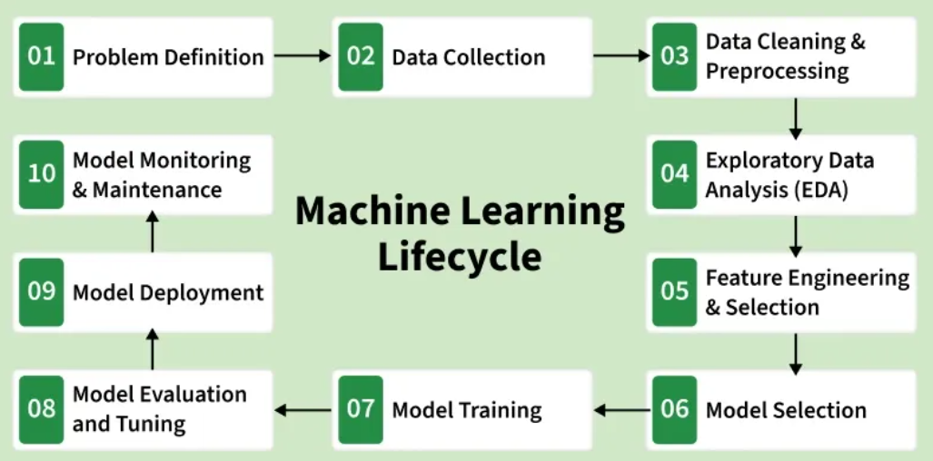

Slide 17
Feature Engineering
Definition: Transforming raw data into meaningful features to improve model performance.
Common Techniques
(a) Handling Missing Values - Mean / Median / Mode or KNN Imputation
(b) Encoding Categorical Variables - Label Encoding (Ordinal), One-Hot Encoding (Nominal)
(c) Feature Scaling - Standardization (Z-score), Min-Max Scaling
(d) Feature Creation - Date features (Year, Month), Interaction features
(e) Feature Selection - Correlation analysis, Recursive Feature Elimination, Feature importance
Impact: > Good features can outperform complex models.

Slide 18
Dataset Split - Training set: 70%, Validation set: 15%, Test set: 15%
Training - Model learns patterns
Validation - Used to tune model, Prevents overfitting
Testing - Final unbiased evaluation
Overfitting vs Underfitting
Model Training, Validation, and Testing
Problem | Cause | Solution
Overfitting | Too complex | Regularization
Underfitting | Too simple | More features

Slide 19
Hyperparameter Tuning
Definition: Optimizing parameters not learned by the model.
Examples - Learning rate, Number of trees, Max depth
Techniques
(a) Grid Search - Tries all combinations, Accurate but slow
(b) Random Search - Random sampling, Faster
(c) Bayesian Optimization - Intelligent search, Efficient
Cross-Validation
K-Fold CV → robust performance estimate

Slide 20
Summary
Concept | Purpose
Supervised | Prediction
Unsupervised | Pattern discovery
Semi-supervised | Reduce labeling cost
Reinforcement | Decision making
Feature Engineering | Improve performance
Hyperparameter Tuning | Optimize model

Slide 21
Supervised Learning
Regression Analysis

Slide 22
Problem
Predict House Price based on House Size (sqft) and Number of Bedrooms.

Slide 23
Problem Understanding
Business Question:
Can we estimate house prices from basic property features?
ML Type:
✔ Supervised Learning
✔ Regression

Slide 24
Data Collection - (Manually created dataset – real projects use CSV / DB / APIs)
import pandas as pd
data = {
"Size_sqft": [800, 900, 1200, 1500, 1800, 2000, 2300],
"Bedrooms": [1, 2, 2, 3, 3, 4, 4],
"Price": [3000000, 3500000, 5000000, 6500000, 7500000, 9000000, 11000000]
}
df = pd.DataFrame(data)
df

Slide 25
Data Cleaning
df.info()
df.isnull().sum()
✔ No missing values
✔ Correct data types
(Real projects → handle nulls, outliers, duplicates)

Slide 26
Exploratory Data Analysis (EDA)
import matplotlib.pyplot as plt
plt.scatter(df["Size_sqft"], df["Price"])
plt.xlabel("Size (sqft)")
plt.ylabel("Price")
plt.show()
🔍 Insights
Price increases as size increases
Bedrooms also positively correlated

Slide 27
Feature Engineering
Split features & target
X = df[["Size_sqft", "Bedrooms"]]
y = df["Price"]
Feature Scaling
from sklearn.preprocessing import StandardScaler
scaler = StandardScaler()
X_scaled = scaler.fit_transform(X)

Slide 28
Model Selection
Chosen Model:
✔ Linear Regression
Why?
Simple
Interpretable
Works well for linear relationships

Slide 29
Model Training
from sklearn.model_selection import train_test_split
from sklearn.linear_model import LinearRegression
X_train, X_test, y_train, y_test = train_test_split( X_scaled, y, test_size=0.2, random_state=42)
model = LinearRegression()
model.fit(X_train, y_train)

Slide 30
Validation & Testing
from sklearn.metrics import mean_absolute_error, mean_squared_error, r2_score
y_pred = model.predict(X_test)
print("MAE:", mean_absolute_error(y_test, y_pred))
print("MSE:", mean_squared_error(y_test, y_pred))
print("R2 Score:", r2_score(y_test, y_pred))
✔ MAE → Average error
✔ MSE → Penalizes large errors
✔ R² → How well model explains variance
Note - “A good regression model has low MAE, controlled MSE, and an R² above 0.7, indicating strong explanatory power and low prediction error.”

Slide 31
Hyperparameter Tuning
Linear Regression has few params → use Ridge Regression
from sklearn.linear_model import Ridge
from sklearn.model_selection import GridSearchCV
params = {"alpha": [0.1, 1, 10, 100]}
grid = GridSearchCV(Ridge(), params, cv=3)
grid.fit(X_train, y_train)
print("Best Alpha:", grid.best_params_)

Slide 32
Deployment & Monitoring (Basic Simulation)
Save Model
import joblib
joblib.dump(model, "house_price_model.pkl")
joblib.dump(scaler, "scaler.pkl")

Slide 33
Load Model & Predict (Deployment Simulation)
model = joblib.load("house_price_model.pkl")
scaler = joblib.load("scaler.pkl")
new_house = [[1600, 3]]
new_house_scaled = scaler.transform(new_house)
predicted_price = model.predict(new_house_scaled)
print("Predicted Price:", predicted_price[0])
Output - Predicted Price: 6956692.91

Slide 34
Regression Metrics

Slide 35

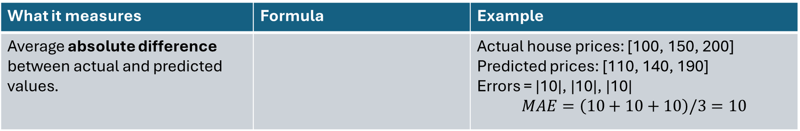
Mean Absolute Error (MAE)
What it measures | Formula | Example
Average absolute difference between actual and predicted values. |  | Actual house prices: [100, 150, 200] Predicted prices: [110, 140, 190] Errors = |10|, |10|, |10| $$MAE=\left(10+10+10\right)/3=10$$
Interpretation | Use cases | How we can improve
 | House price prediction Salary estimation Demand forecasting | ✔ Feature engineering ✔ Remove outliers ✔ Try non-linear models ✔ Add more relevant data
Value | Meaning
0 | Perfect model
Low MAE | Predictions are close
High MAE | Large average error

Slide 36
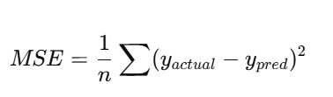
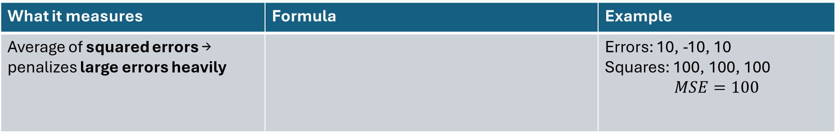
Mean Squared Error (MSE)
What it measures | Formula | Example
Average of squared errors → penalizes large errors heavily |  | Errors: 10, -10, 10 Squares: 100, 100, 100 $$MSE=100$$
Interpretation | Use cases | How we can improve
 | When large mistakes are very costly Financial risk models Critical systems | ✔ Reduce outliers ✔ Use Robust Regression ✔ Transform target (log, sqrt)
Value | Meaning
0 | Perfect model
Large value | Big errors exist

Slide 37


Root Mean Squared Error (RMSE)
What it measures | Formula | Example
Square root of MSE → error in original units
Interpretation | Use cases | How we can improve
 | Weather prediction Stock price forecasting Engineering problems | ✔ Feature scaling ✔ Use ensemble models ✔ Reduce noise in data
Value | Meaning
0 | Perfect model
RMSE > MAE | Model makes large errors

Slide 38



R² Score (Coefficient of Determination)
What it measures | Formula | Example
How much variance in target is explained by the model
Interpretation | Use cases | How we can improve
 | Model comparison Business performance explanation | ✔ Add meaningful features ✔ Try polynomial regression ✔ Remove irrelevant variables
R² Value | Meaning
1.0 | Perfect fit
0.9 | Very good
0.7 | Acceptable
0 | No better than mean
Negative | Worse than baseline

Slide 39
Adjusted R²
What it measures | Formula | Example
R² always increases when adding features—even useless ones. | Square of R Value | Adjusted R² penalizes unnecessary features.
Interpretation | Use cases | How we can improve
 | Feature selection Multiple Linear Regression | ✔ Remove multicollinearity ✔ Use Lasso / Ridge
Case | Meaning
Adjusted R² ↑ | Feature is useful
Adjusted R² ↓ | Feature is useless

Slide 40

Mean Absolute Percentage Error (MAPE)
What it measures | Formula | Example
Error as a percentage
Interpretation | Use cases | How we can improve
 | Sales forecasting Business KPI prediction | ✔ Remove zero values ✔ Use SMAPE ✔ Normalize data
MAPE | Quality
< 10% | Excellent
10–20% | Good
20–50% | Average
> 50% | Poor

Slide 41
Metric | Best / Ideal | Very Good | Acceptable | Poor / Not Good | Notes
MAE | ≈ 0 | ≤ 5% of target range | ≤ 10–15% of target range | > 20% of target range | Depends on data scale
MSE | ≈ 0 | Very small (relative) | Moderate | Very large | Hard to interpret directly
RMSE | ≈ 0 | ≤ 10% of mean target | ≤ 20% of mean target | > 30% of mean target | Penalizes big errors
R² | 1.0 | ≥ 0.90 | 0.70 – 0.89 | < 0.60 | Negative = very bad
Adjusted R² | 1.0 | Close to R² | Slightly lower than R² | Much lower than R² | Penalizes useless features
MAPE | 0% | < 10% | 10–20% | > 30% | Fails if actual = 0

Slide 42
Thank you

